Slide 1

GPS BASED TOLL COLLECTION SYSTEM
BATCH 3
Presented by:
Ch. SIVA NAGA JAYAVARDHAN(Y18AEC570)
E.HEMANTH(Y18AEC429)
A.JAGADEESH(Y18AEC401)
B.NAGA CHANDRIKA(Y18AEC409)
J.DURGA RAMA KRISHNA(Y18AEC444)
Under the esteemed guidance of
Dr. CH. V. M. S. N. PAVAN KUMAR sir,
Mtech , Ph. D, associate professor

Slide 2
CONTENTS
ABSTRACT
EXISTING TOLL COLLECTION SYSTEMS
PROBLEMS IN EXISTING TOLL COLLECTION SYSTEM
OUR IDEA
BLOCK DIAGRAM
COMPONENTS
HOW DOES GPS BASED TOLL SYSTEMS WORK
ADVANTAGES

Slide 3
CONTENTS
DISADVANTAGES
REFERENCES
OUTPUT
RESULT

Slide 4
ABSTRACT
The requirement for vehicles to halt for toll fee payment results in traffic congestion and reduces fuel efficiency. In this paper, hardware and software designs were involved to develop a GPS-based highway toll collection system. The system utilised the Arduino uno as the microcontroller.
Additional electronic modules such as GPS module, LCD module, speaker, wireless Wi-Fi router modem and wireless Wi-Fi adapter were included to perform specific tasks. The system utilised GPS coordinates(longitude and latitude values) to track vehicle and toll fees were incurred at predefined points. The travel summary was recorded in the online database.

Slide 5
ABSTRACT
Furthermore, an automatic delay time adjustment system was studied and was implemented to reduce the power consumption of the system without compromising the accuracy. A personal cloud server was configured to allow online access of travel logs. The developed system promises motorists a smooth travel journey and eliminates the construction of expensive toll booths.

Slide 6
EXISTING TOLL COLLECTION SYSTEMS
Manual toll collection is most widely used collection method in India. It requires a toll collector or attendant. Based on the vehicle classification, cash toll is received by the collector.
FASTag method: FASTag (RFID Tag) is affixed on the windscreen of the vehicle and enables a customer to make the toll payments directly from the account which is linked to FASTag.

Slide 7
PROBLEMS IN EXISTING TOLL COLLECTION SYSTEM
In both the systems vehical must stop at the toll gates,toll tunnels.
So We can observe lengthy queue near toll gates on a proper day. As a result time is being wasted for many .
Some toll gates are charging even after their time period.

Slide 8
OUR IDEA
So to tackle these problems,we'd like to implement a GPS based system which automatically collects money.
OUR IDEA IS TO:
1.Track the vehicle and see if it crosses a region.
2.We're doing with a sample bank account.
3.As soon as the vehicle crosses a region,GPS will track it and money will be cut automatically from the tags .

Slide 9
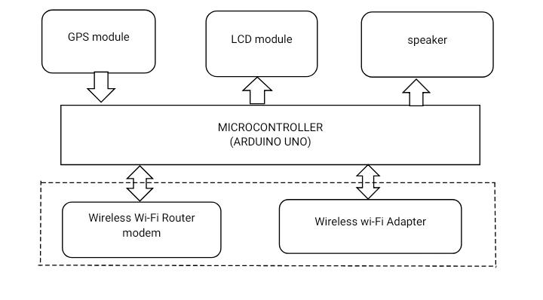
BLOCK DIAGRAM

Slide 10
COMPONENTS
•Arduino UNO
GPS Module
LCD Display
WIFI Router

Slide 11
ARDUINO UNO:
The Arduino Uno is an open-source microcontroller board based on the Microchip ATmega328P microcontroller and developed by Arduino.cc.
The board is equipped with sets of digital and analog input/output (I/O) pins that may be interfaced to various expansion boards (shields) and other circuits.
The board has 14 digital I/O pins (six capable of PWM output), 6 analog I/O pins, and is programmable with the Arduino IDE (Integrated Development Environment), via a type B USB cable.
It can be powered by the USB cable or by an external 9-volt battery, though it accepts voltages between 7 and 20 volts. It is similar to the Arduino Nano and Leonardo

Slide 12
GPS MODULE
Global Positioning System (GPS) makes use of signals sent by satellites in space and ground stations on Earth to accurately determine its position on Earth.
The NEO-6M GPS receiver module uses USART communication to communicate with microcontroller or PC terminal.It receives information like latitude, longitude, altitude, UTC time, etc. from the satellites in the form of NMEA string.
This string needs to be parsed to extract the information that we want to use

Slide 13
LCD DISPLAY
•The LiquidCrystal library allows you to control LCD displays that are compatible with the Hitachi HD44780 driver.
There are many of them out there, and you can usually tell them by the 16-pin interface. This example sketch prints "Hello World!" to the LCD and shows the time in seconds since the Arduino was reset

Slide 14
WIFI ROUTER
•wireless router is a device that performs the functions of a router and also includes the functions of a wireless access point.
It is used to provide access to the Internet or a private computer network.
Depending on the manufacturer and model, it can function in a wired local area network, in a wireless-only LAN, or in a mixed wired and wireless network

Slide 15
HOW DOES GPS BASED TOLL SYSTEMS WORK:
•Let us assume a highway. At the beginning,we will give the longitudinal and latitudinal values of the toll collecting point and the highway ending point to our prototype .
The GPS as we know will constantly monitors the longitudinal and latitudinal values every now and then.
As soon as the car comes to the toll collecting region,the values will match and the device marks this point.

Slide 16
HOW DOES GPS BASED TOLL SYSTEMS WORK:
As soon as the Car reaches highway end point ,those values will now match with those of GPS and the amount will be deducted
If the person travels within the highway ,he doesn't need to pay the full amount as the distance travelled is less.
Here in this case only toll gate values are verified and the amount will be deducted based on the distance travelled

Slide 17
ADVANTAGES
•Saves huge amount of time .
As the amount will be deducted according to the distance travelled,Money will be saved.
No toll jumping can occur as this is based on GPS.

Slide 18
DISADVANTAGE
A device is necessary for every car which is one of the disadvantages.
But as the technology moves further,we are hoping that this device will be mounted while assembling the car itslef

Slide 19
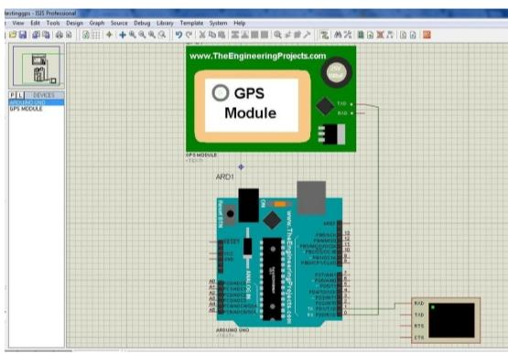
OUTPUT:GPS SIMULATOR ONLINE USING PROTEUS
Till now , we have completed the software part of the project. Here are the results

Slide 20
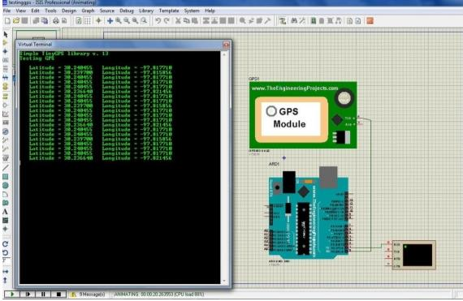
RESULT

Slide 21
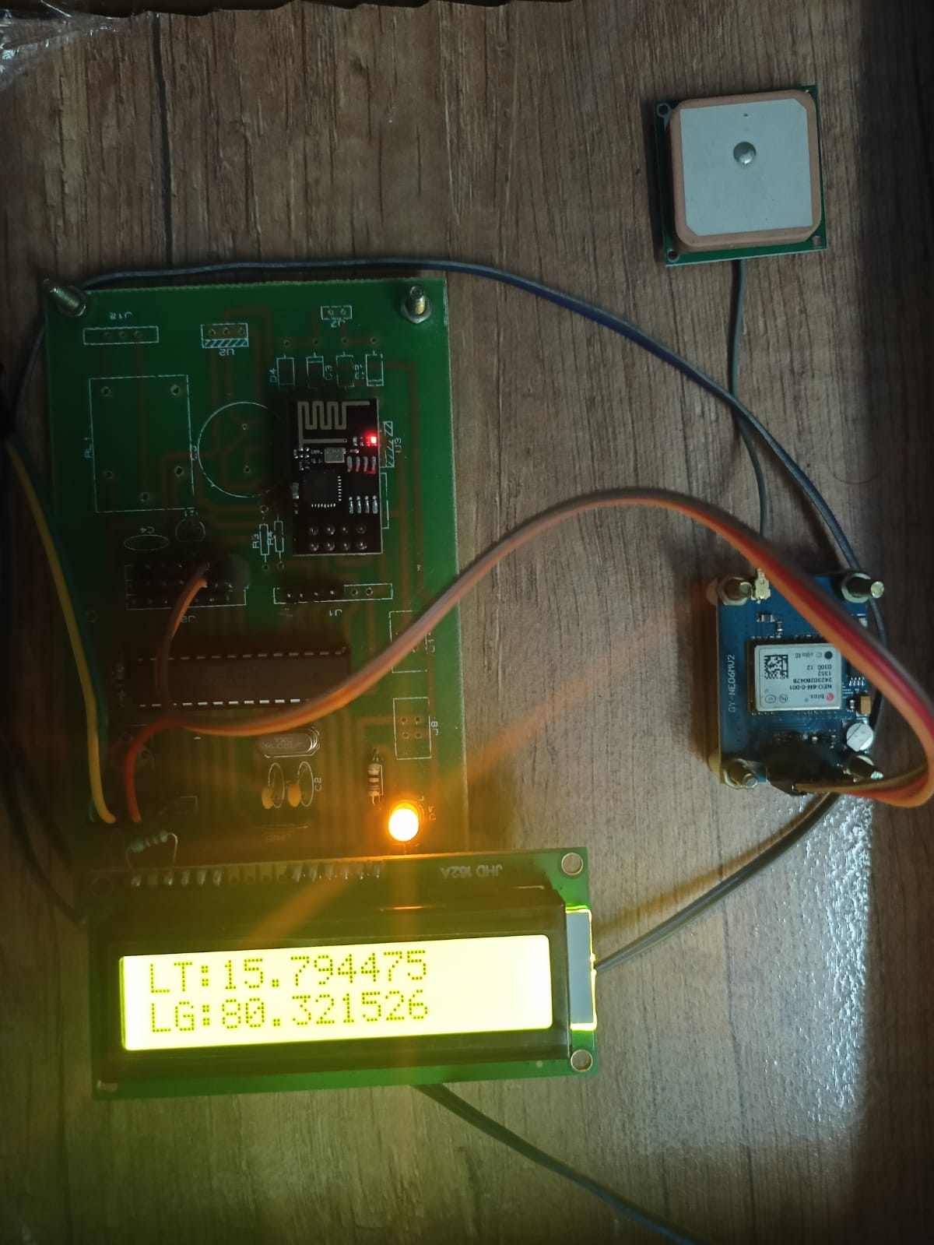
RESULT

Slide 22
REFERENCES:
Adafruit Ultimate GPS Breakout – 66 channel w/10 Hz updates – Version 3. (n.d.). Retrieved July 7, 2015, from https://www.adafruit.com/product/746 [Google Scholar]
2. Brussels. (1998, July 22). Fair payment for infrastructure use: A phased approach to a common transport infrastructure charging framework in the EU. Commission of the European Communities White Paper. [Google Scholar]
3. Catling, I. (2000). Road user charging using vehicle positioning systems. In Proceeding of IEEE International Conference on Road Transport Information and Control (pp. 126–130). London: IEEE.10.1049/cp:20000118 [Crossref], [Google Scholar

Slide 23
THANK YOU

